Slide 1
Game of Fifteen
OOM PROJECT (IOOM332C)
Presented by -
M Diwakar IIT2015051
P Dinesh IIT2015060
Ch Krishna Vamshi IIT2015056
M Raj Kumar IIT2015062

Slide 2
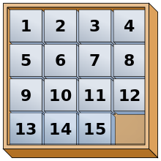
About the Game
The 15-puzzle (Game of Fifteen) is a sliding puzzle that consists of a frame of numbered square tiles in random order with one tile missing.
We have to swap the empty tile with the adjacent tiles until every number in the game stays at it’s original position.
The puzzle also exists in other sizes, creating a lot of new possibilities.

Slide 3
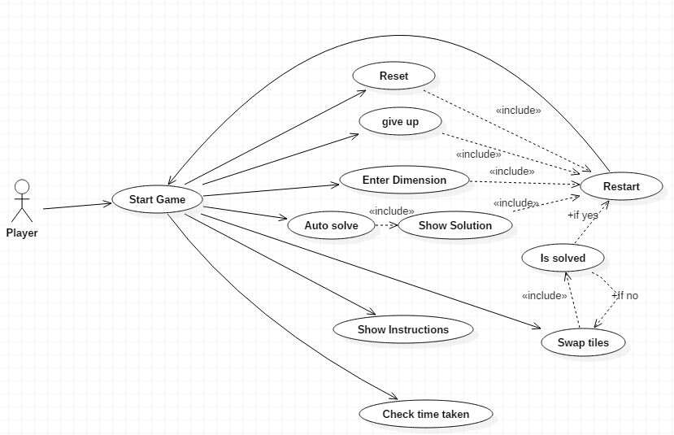
Use-Case Diagram

Slide 4
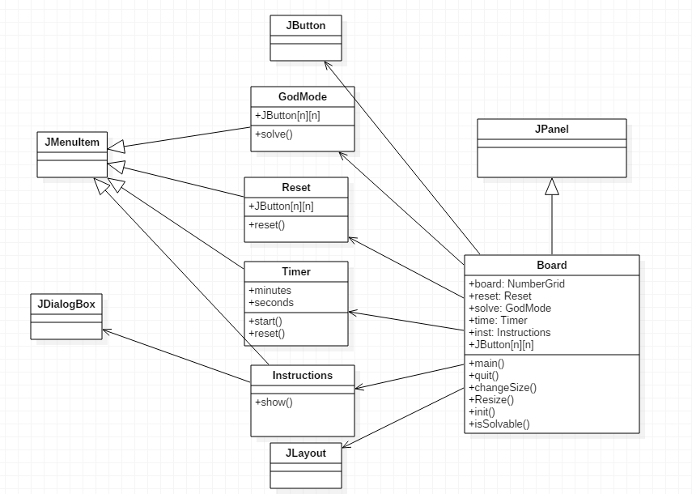
Class Diagram

Slide 5
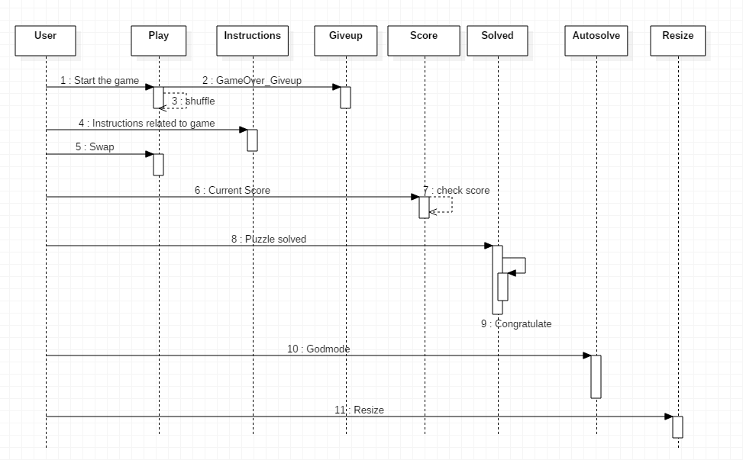
Sequence Diagram

Slide 6
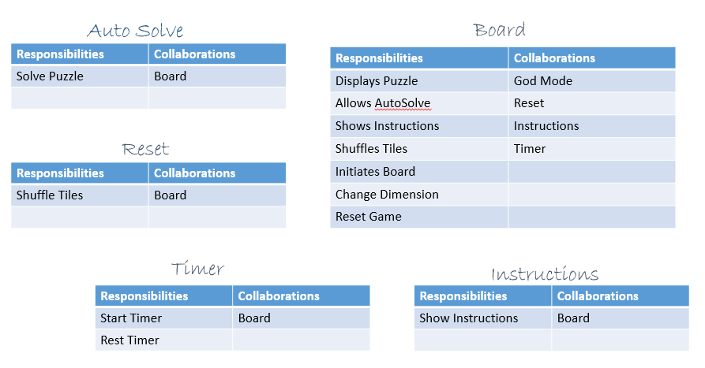
Class Responsibility Collaborator (CRC) Diagram

Slide 7
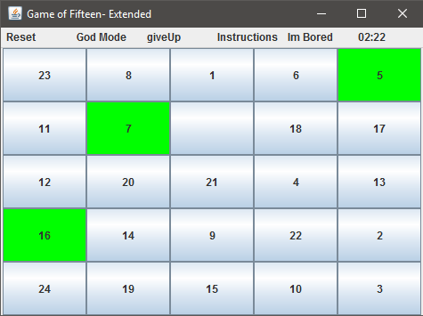
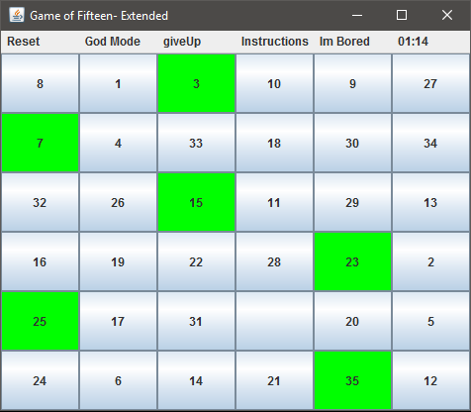
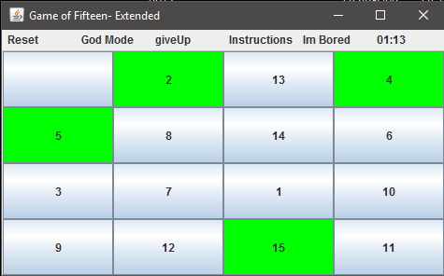
Snapshots

Slide 8
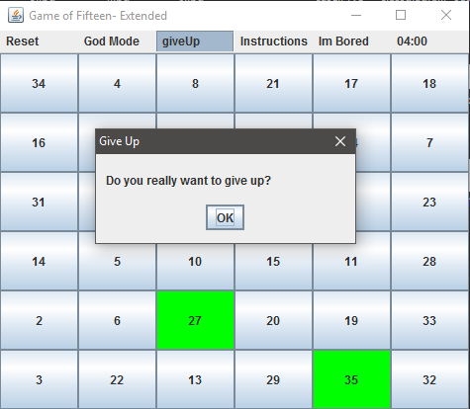
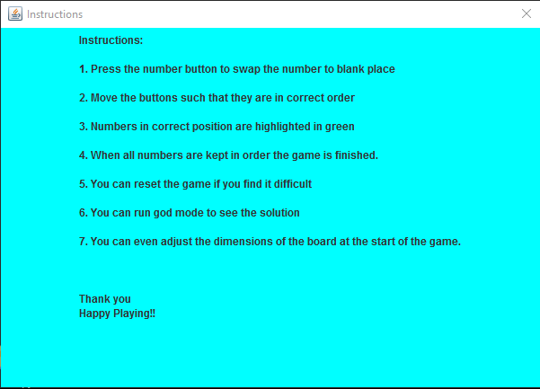
Snapshots

Slide 9
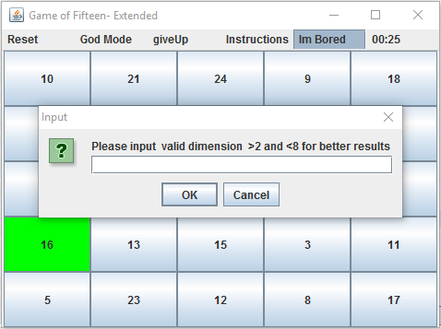
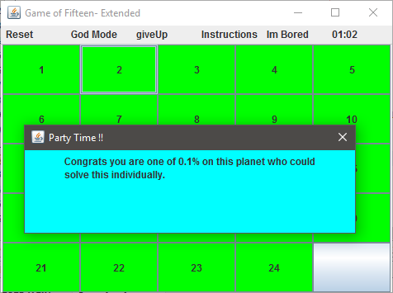
Snapshots

Slide 10
Thank you

